Slide 1

Online Dating
The Use of the Internet to Meet Partners
Alekya Kumar
Trupti Jadhav

Slide 2
Agenda
01 Introduction
02 Information of Dataset
03 Methodologies/Analysis
04 Findings
05 Conclusion

Slide 3

Dataset Overview
Data contains 17,359,346 anonymous ratings of 168,791 profiles made by 135,359 users.
UserID - user who provided rating.
ProfileID - user who has been rated.
UserIDs range between 1 and 135,359.
ProfileIDs range between 1 and 220,970 (not every profile has been rated).
Ratings are on a 1-10 scale where 10 is the best (integer ratings only).
Only users who provided at least 20 ratings were included.
Users who provided constant ratings were excluded.

Slide 4
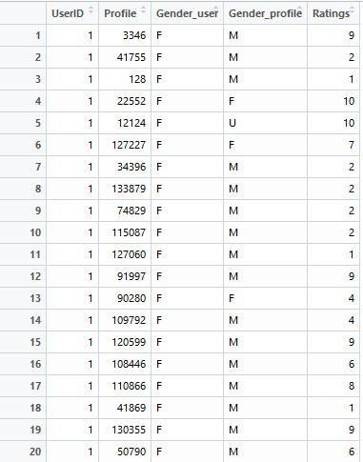
Dataset

Slide 5
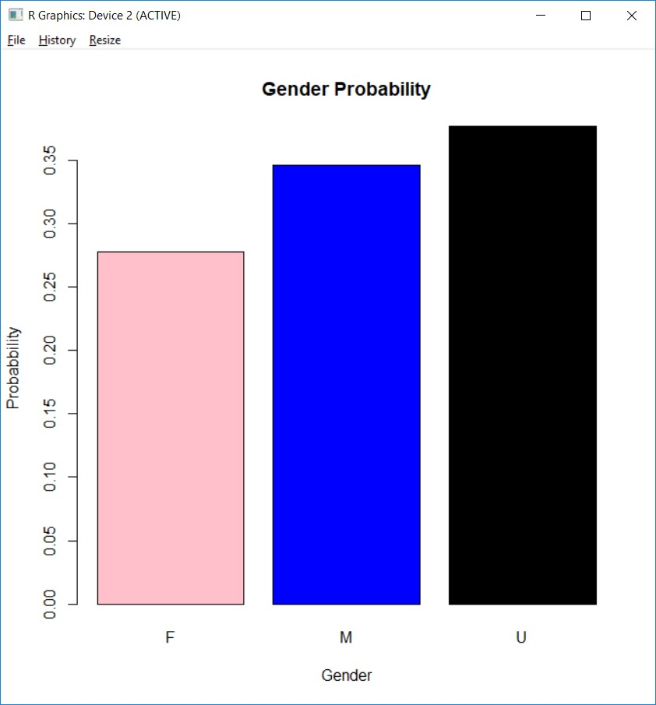

Data Analysis

Slide 6
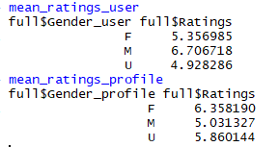
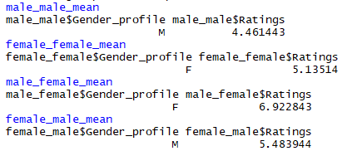
Data Analysis

Slide 7
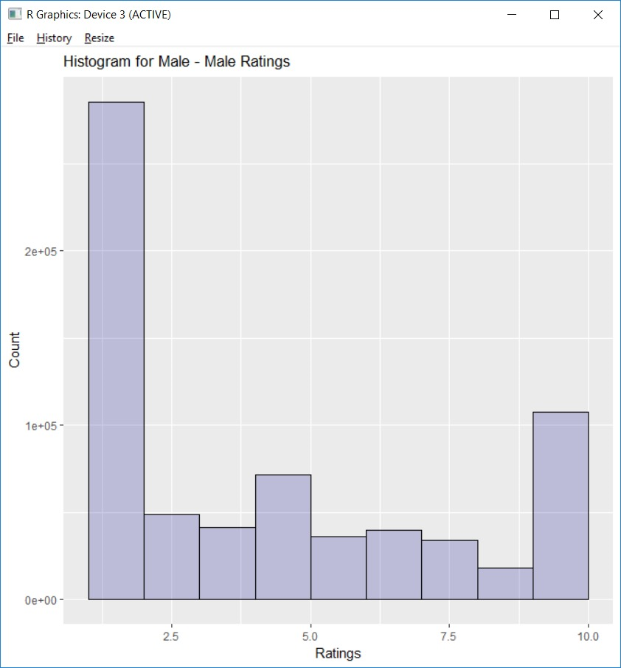
Male-Male Ratings

Slide 8
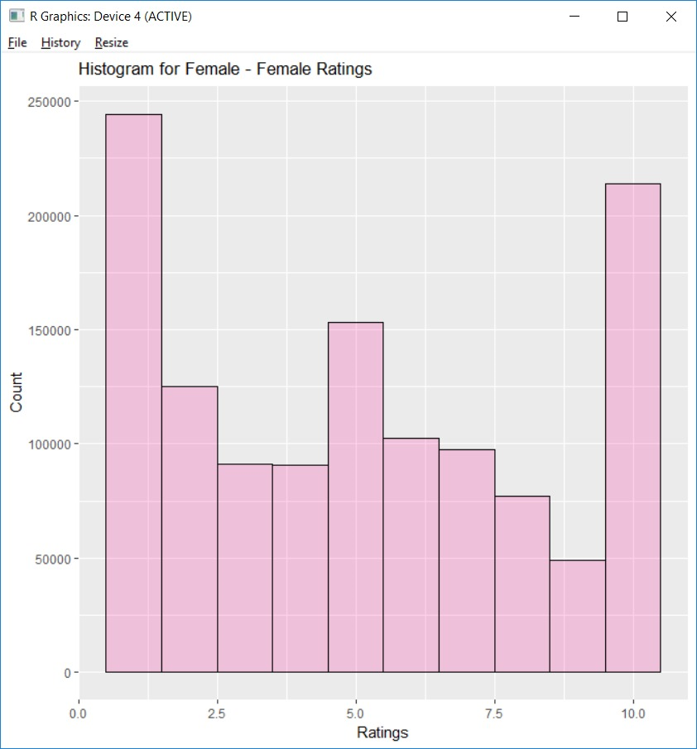
Female-Female Ratings

Slide 9
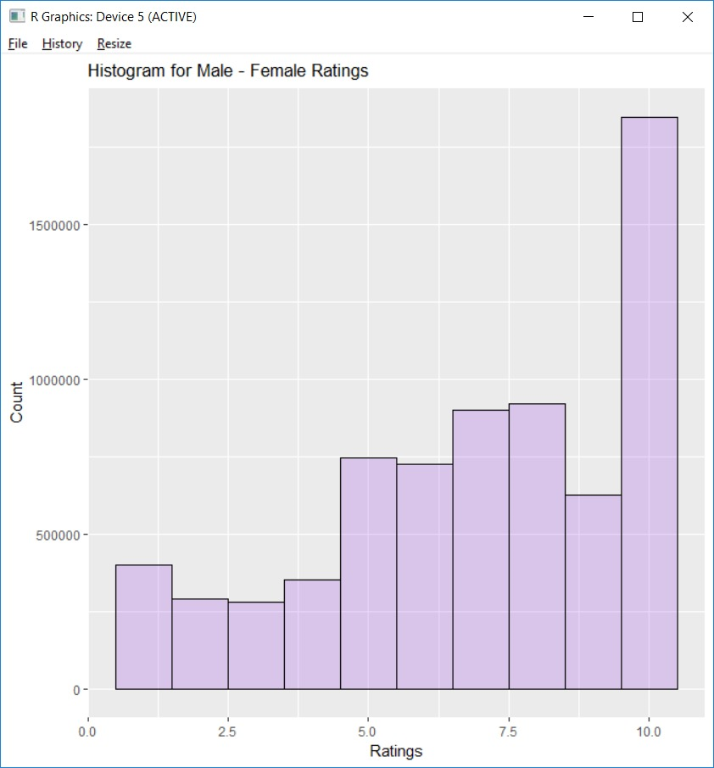
Male-Female Ratings
Notes:
9

Slide 10
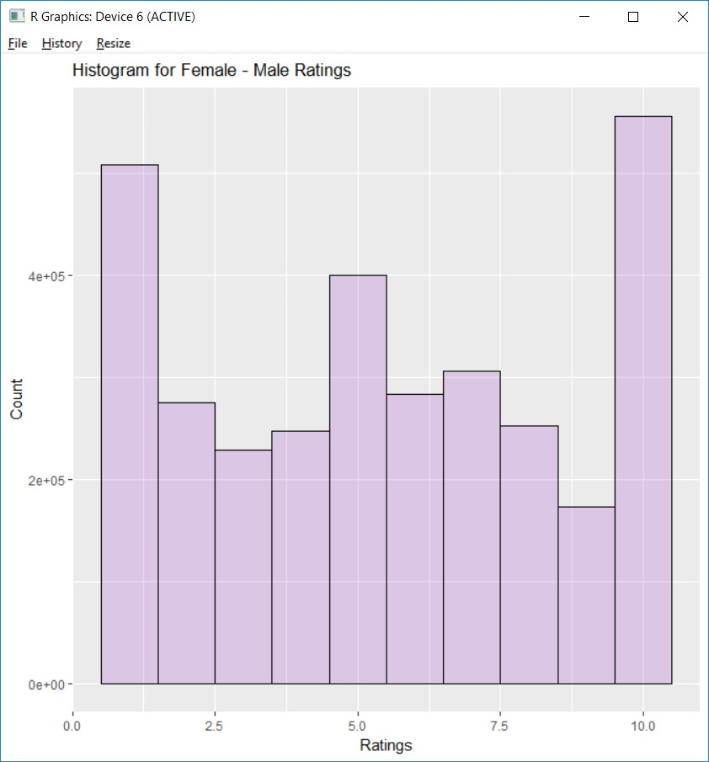
Female-Male Ratings

Slide 11
Why Collaborative Filtering ?
We don’t have the set of features about a profile to come up with recommendations,instead we have ratings. So Content based recommender system was ruled out.
Based on similarities/likings of the users and taking the likings which are repeated the most,we have come up with certain recommendations.

Slide 12
Building Recommender System
A total of 3 x 3 = 9 models were constructed and evaluated.
Similarity(Cosine similarity)
Normalization
Non-normalized
centered
z-score

Slide 13
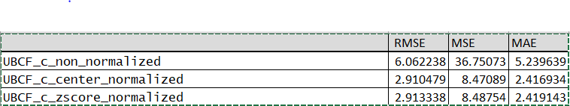
Cosine Similarity Errors
Centering based Normalization outperformed Z-score normalization and both of those normalization outperformed the model constructed using non-normalized data.

Slide 14
Building Recommender System
Similarity(Pearson Correlation as similarity)
Normalization
Non-normalized
Centered
Z-score

Slide 15
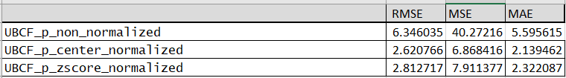
Pearson Correlation Errors
Centering based Normalization outperformed Z-score normalization and both of those normalization outperformed the model constructed using non-normalized data.

Slide 16
Building Recommender System
Similarity(Euclidean Distance as similarity)
Normalization
Non-normalized
centered
z-score

Slide 17
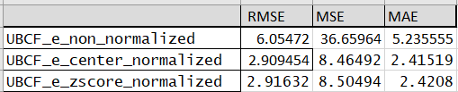
Euclidean Distance Errors
Centering based Normalization outperformed Z-score normalization and both of those normalization outperformed the model constructed using non-normalized data.

Slide 18
Next Part...
After building and evaluating various models, the best one was chosen, which is Pearson correlation with centered normalization model and predictions were also made for the same
Build a model based on Popularity metric.
Compared the results for both the recommender lists using the same set of users.

Slide 19
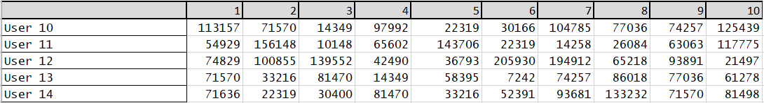
Top 10 recommendation for 5 users(Pearson-centered norm.)

Slide 20
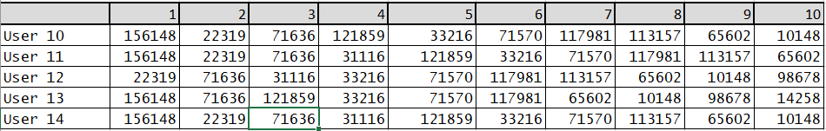
Top 10 recommendation for 5 users(Popularity)

Slide 21
Conclusion
As the tables show, the 3 UBCF model employing raw, non-normalized data were the poorest performing UBCF models assessed herein.
Thus normalization of the data appears to improve the UBCF model regardless of which similarity metrics is employed.
The errors for Pearson Correlation approach is lesser than the other two approaches.
As such, the Pearson Correlation should be preferred over Cosine similarity and Euclidean Distance metrics when developing a user based collaborative filtering recommender for our dataset.
From the popularity method, we can see that few sets of profiles are constant being picked many times. This is because those set of profiles have higher popularity within the users.

Slide 22
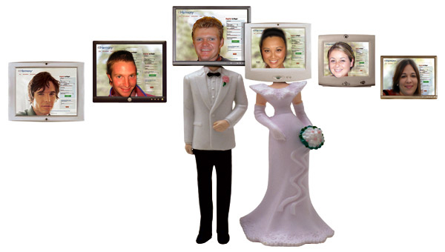
Questions/Comments?

Slide 23
THANKYOU!!!

